Slide 1
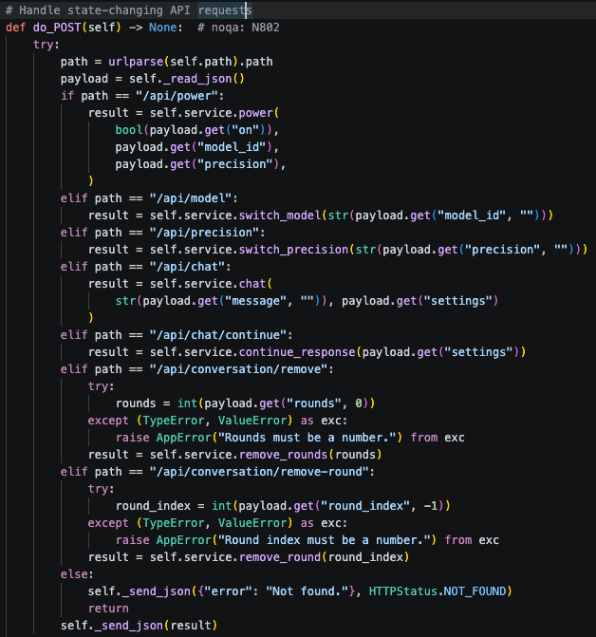
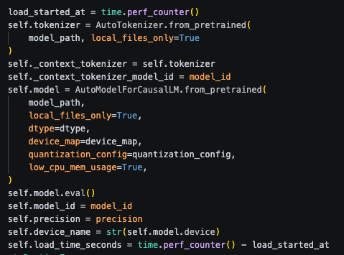
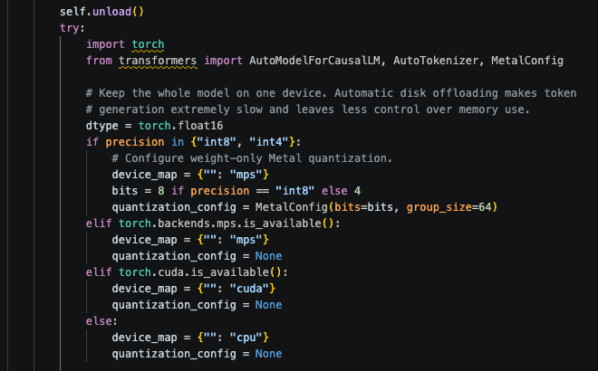
APPENDIX A — KEY IMPLEMENTATION CODE
1 · DEVICE SELECTION & METAL QUANTIZATION
2 · MODEL LOADING & PRECISION SELECTION
3 · GUI BACKEND REQUEST HANDLING
Notes:
[Sources]
- Appendix labels and note supplied directly by the presenter.
- No code or screenshots inserted.
- No external assets used.

Slide 2
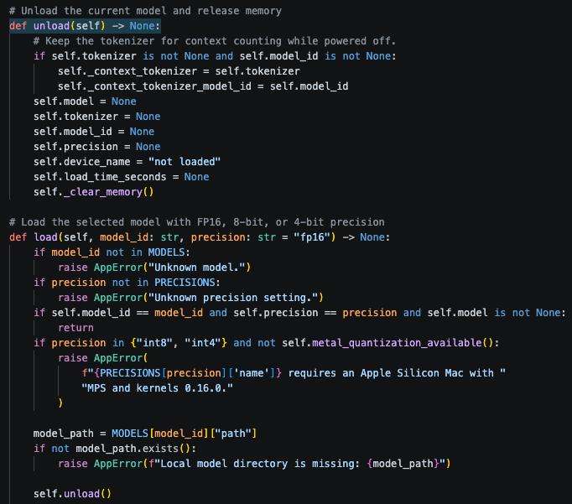
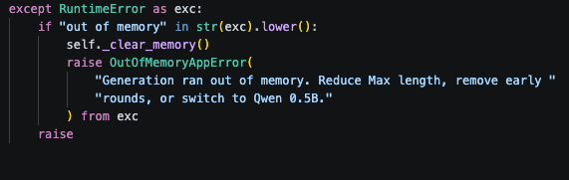
APPENDIX B — MODEL SWITCHING &
OOM HANDLING
MODEL-SWITCHING CODE
OOM DETECTION & RECOVERY CODE
OOM detected → clear memory → controlled error → application stays usable
Switch model → unload previous model → clear MPS cache → load new configuration
Notes:
[Sources]
- Appendix labels and model-switching flow supplied directly by the presenter.
- No code or screenshots inserted.
- No external assets used.

Slide 3
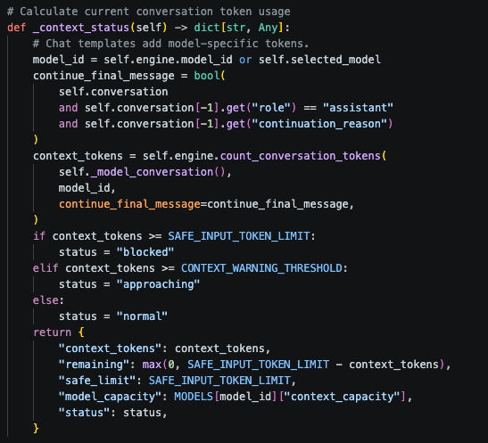
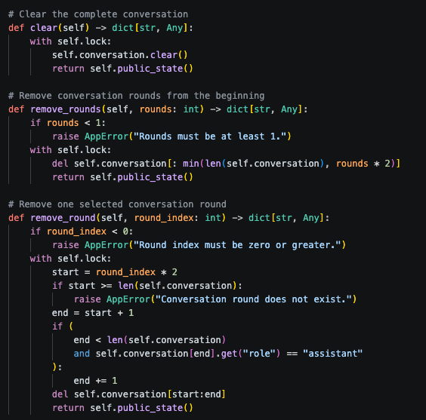
APPENDIX C — CONTEXT & TOKEN SAFEGUARDS
2500-TOKEN SAFETY BUDGET / CONTEXT HANDLING
CONVERSATION CLEAR / REMOVE / HISTORY LOGIC
Notes:
[Sources]
- Appendix labels supplied directly by the presenter.
- No code or screenshots inserted.
- No external assets used.

